Slide 1



PRESENTED BY:
M.SIVATHMIKA (24KB1A3056) J.ARCHANA(24KB1A3034) P.VIKITHA(24KB1A3084)

Slide 2
INTRODUCTION:
THE HOTEL RESERVATION SYSTEM IS A C-PROGRAMMING LANGUAGE CONSOLE APPLICATION THAT ENABLES HOTEL STAFF TO MANAGE ROOM BOOKINGS EFFICIENTLY. THIS PROJECT SIMPLIFIES THE PROCESS OF HANDLING RESERVATIONS, CALCULATING CHARGES , AND MAINTAINING RECORDS.

Slide 3
OBJECTIVE :
THE OBJECTIVE OF THIS PROJECT IS TO DESIGN AND IMPLEMENT HOTEL RESERVATION SYSTEM USING THE C PROGRAMMING LANGUAGE. THE SYSTEM AIMS TO SIMPLIFY THE PROCESS OF MANAGING HOTEL BOOKINGS BY ALLOWING USERS TO:
ADD , MODIFY, DELETE, AND SEARCH HOTEL RESERVATIONS.
CALCULATE TOTAL CHARGES BASED ON ROOM TYPE (AC/NON-AC) AND NUMBER OF DAYS STAYED.
DISPLAY ALL RESERVATIONS IN A STRUCTURED FORMAT.
THIS PROJECT DEMONSTRATES PRACTICAL USE OF STRUCTURES, ARRAYS, FUNCTIONS, CONDITIONAL LOGIC, STRING HANDLING, AND
FILE OPERATIONS IN C, WHILE ALSO REINFORCING THE IMPORTANCE OF USER INPUT VALIDATION AND MENU-DRIVEN PROGRAMMING
DESIGN.

Slide 4
WHY WE USED C POGRAMING LANGUAGE FOR THIS PROJECT ?
1 ) SIMPLICITY & CONTROL:
C GIVES LOW-LEVEL ACCESS TO MEMORY AND SYSTEM RESOURCES, IDEAL FOR LEARNING AND UNDERSTANDING HOW PROGRAMS
REALLY WORK.
EFFICIENT EXECUTION :
PROGRAMS WRITTEN IN C ARE FAST AND LIGHTWEIGHT, MAKING THEM SUITABLE FOR SMALL SYSTEMS AND COMMAND-LINE TOOLS.
LEARING:
BY C PROGRAMING LANGUAGE WE CAN GET CRITICAL THINKING SKILLS AND LOGIC DEVELOPMENT

Slide 5
STRUCTURE DATA USED :
RESERVATION STRUCTURE :
struct Reservation { int customer ID; char name[50];
int roomNumber; int daysBooked;
float totalAmount;
char roomType[10] ; // AC or Non-AC
};

Slide 6


calculateAmount(int days, char roomType[]):
FUNCTIONS USED IN THE CODE :
Calculates total amount based on room type and number of days. addReservation():
Checks for duplicate IDs and adds new reservation.
displayReservations():
Displays all reservations in a formatted table. searchByID(int id):
Searches for a reservation using customer ID.

Slide 7




searchByName(char name[]):
Searches for a reservation using customer name. modifyReservation(int id):
Modifies existing reservation details. deleteReservation(int id):
Deletes a reservation after user confirmation. saveToFile():
Saves all reservations to a textfile for persistence.

Slide 8
SOURCE CODE :

Slide 9
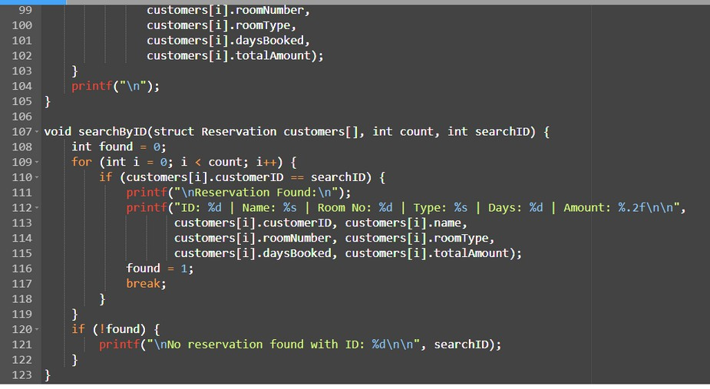
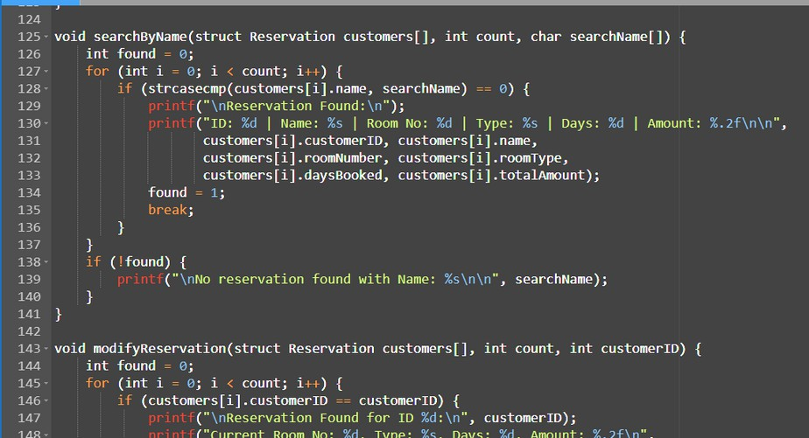
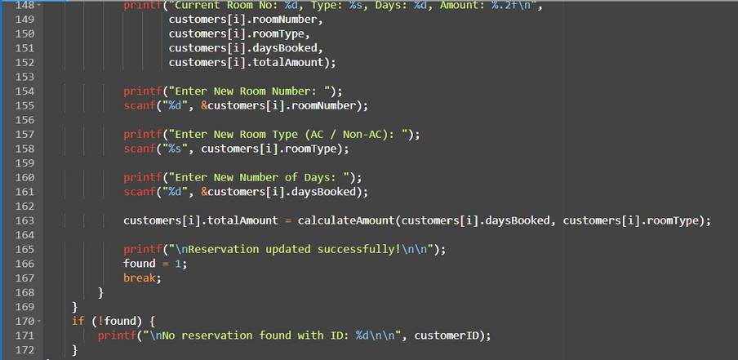
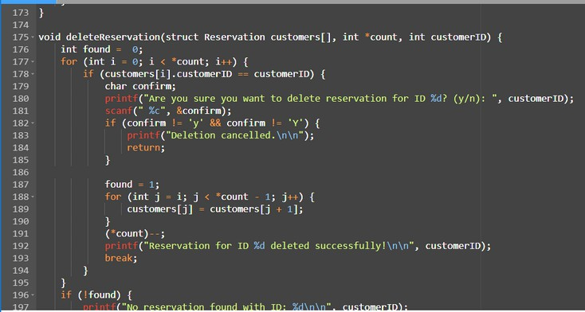
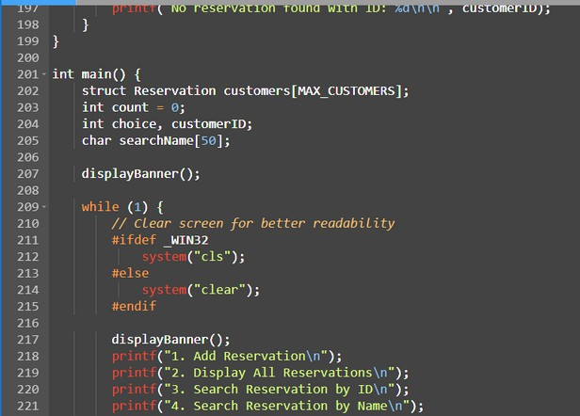
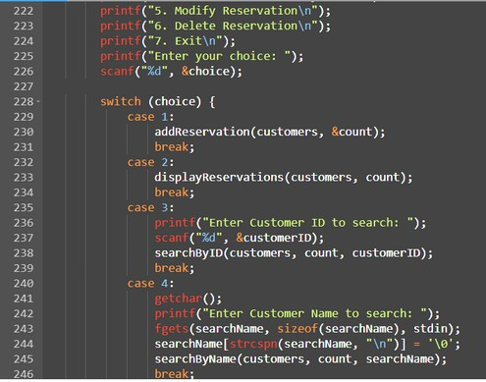
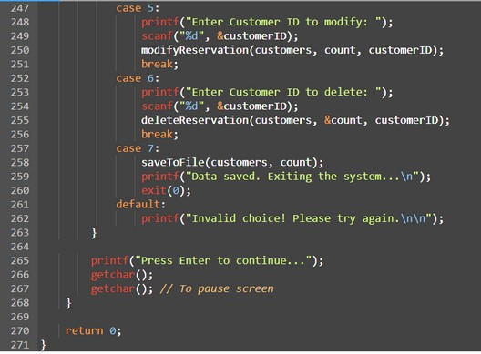

Slide 10
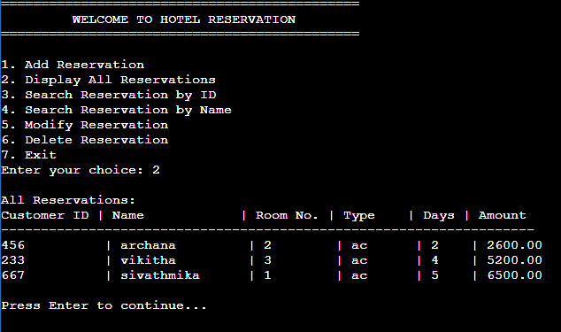
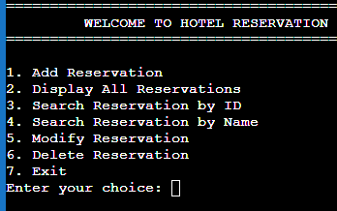
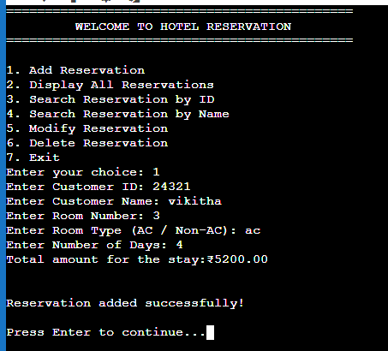
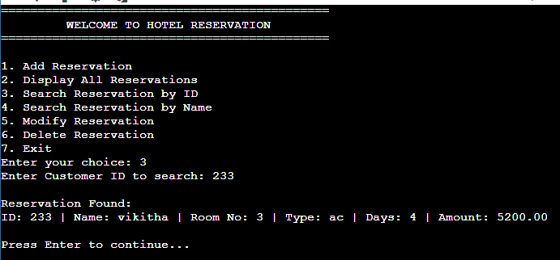
OUTPUT DISPLAY
user choose 1
user see in menu
user choose 3
user choose 2

Slide 11
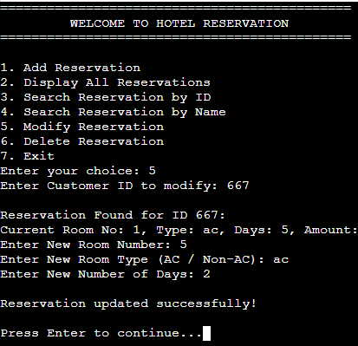
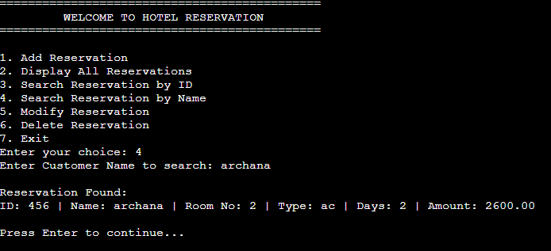
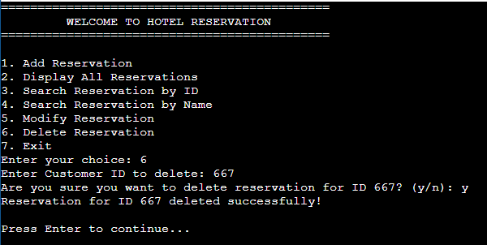
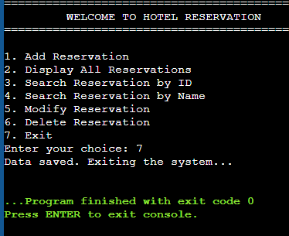
user choose 5
user choose 4
user choose 6
user choose 7

Slide 12
CONCLUSION :
The Hotel Reservation System developed using C programming successfully demonstrates how basic data managementtasks—such as adding, modifying, searching, displaying, and deleting reservations—can be implemented using structured programming techniques.

Slide 13
FUTURE ENHANCEMENTS :
Graphical User Interface (GUI):
Integrating a GUI using tools like GTK (for C) which can improve user experience.
Database Integration:
Replacing file handling with a database (like MySQL or SQLite) for more secure, scalable, and efficient data management.
Customer Login System:
Adding authentication features such as user accounts and admin privileges to restrict
unauthorized access.
Billing and Invoicing Module:
Generating printable bills or invoices for customers with tax calculations and service
charges.
Online Booking Capability:
Enhancing the system to accept bookings through a website or mobile application via internet connection

Slide 14
QUERIES AND RESPONSES)
Any questions and queries are taken

Slide 15





